Slide 1

Neighborhood Safety and Airbnb Short-term Housing Price in Boston
Presenters: Irene Ham Liu, Yujia He and Yijie Zhi
UEP-293-06 Urban Analytics and Visualization. Tufts University
December 9th, 2019.

Slide 2
Background
In terms of user safety, in the US and other major countries Airbnb does not require any ID other an email address and phone number.
Crime as a price determinant for long-term housing vs short-term housing.
Airbnb neighborhood safety measures.
Spatial correlation of Airbnb Crime and Pricing.

Slide 3
Research Questions
Do certain types of crimes affect housing price differently for short-term and long-term housing?

Slide 4
Data sources
Airbnb data: dataset about location (longitude and latitude), price, room type etc. for Airbnb house in 2018 in Boston.
Long term housing data: dataset about location (detail address in street), price etc. for long term house in 2016 in Boston.
Crimes data: dataset about crime incidents in 2018 in Boston with its type, occurrence time, location (longitude and latitude) information etc.
Census tract data: dataset about the geo-information of each census tract in U.S. Census 2010 in Boston.

Slide 5
Level of detail
The reason why we choose census tract instead of neighborhood or census block group:
Although we could merge our data into neighborhood, the problem is that the whole Boston area only have about 50 neighborhoods which is not enough for our analysis, and in the meanwhile too large research area may lead to wrong crimes or housing value summary (e.g. if crime incident happening clustered in a small district, the crimes level in this area can’t represent the whole neighborhood).
And the problem for census block group is opposite, since in our data there may lack of crimes incident records in some census block group, so if we want to make further research in census block group level, we need to collect more crimes data in several years.

Slide 6
Assumptions
We assume the owners and buyers of long term house and Airbnb house have access to clearly understand the crimes level in this area
We assume the crimes level in 2018 in Boston is normal and can be regarded as the representative of recent years crimes situation in Boston
We assume the Airbnb data and housing data is normal and can be regraded as the representative of recent years short term and long term housing price situation in Boston

Slide 7
DATA pre-processing
We drop all the data without record (NAN) and record "0" in housing price and then select the location and price of each housing point.
We select several types of crimes, find the corresponding census tract of these crimes points and then calculate the crimes level in each selected type 2018 in each census tract in Boston.
We do the same thing to Airbnb and long term housing data to aggregate them into census tract level and then get the median value of short term and long term housing in each census tract.

Slide 8
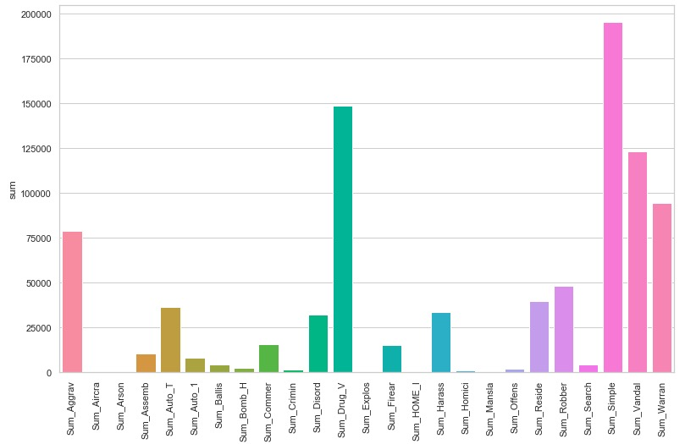
Distribution of the CRIME data

Slide 9
1.Simple Assault happens most frequently, next is Drug Violation, the third one is vandalism
The least happened crimes are Aircraft, Explosives, and Manslaughter
2. However, we are not sure whether the more frequent crime have more serious impact to both Airbnb and housing price
3. Statistical analysis: try to find the significant impact crime types for Airbnb price and housing price across the city of Boston census tracts

Slide 10
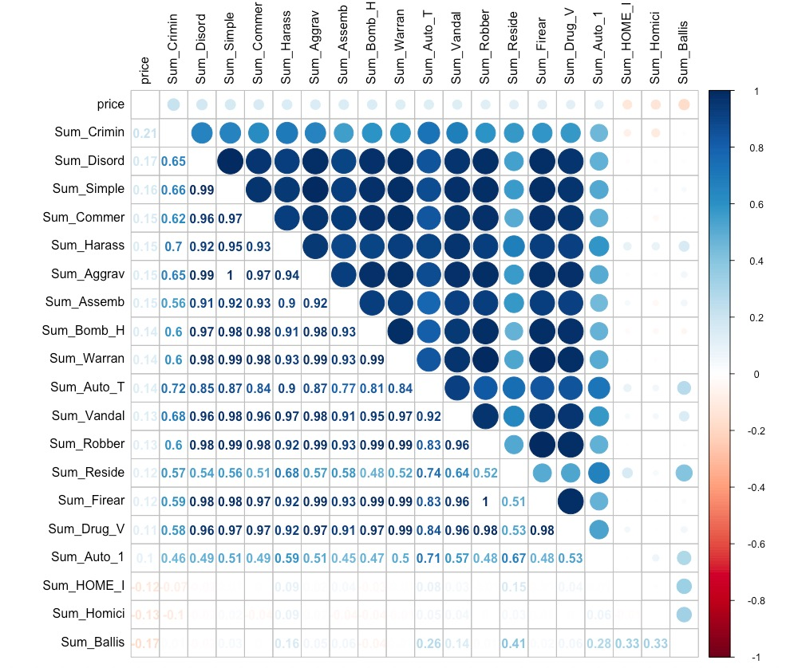
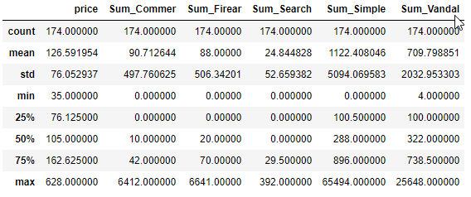
Exploratory Data Analysis —AIRBNB
Multicollinearity is a problem
Perform variable selection: we use stepwise regression model to avoid multicollinearity
Ranges of Dependent variable and independent variables are similar so there is no need to normalize data.

Slide 11
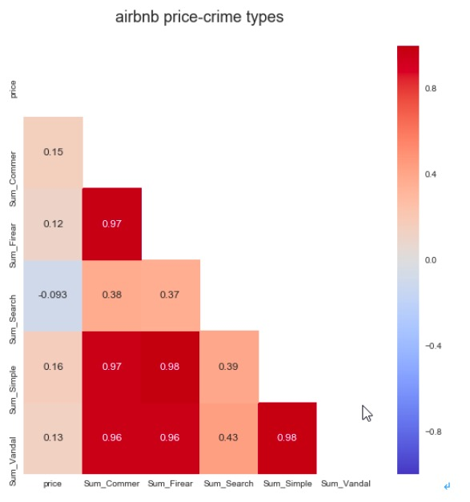
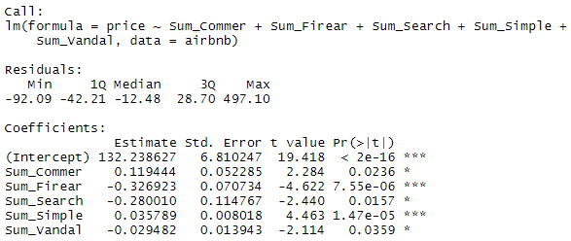
Exploratory Data Analysis —AIRBNB
Stepwise Model:

Slide 12
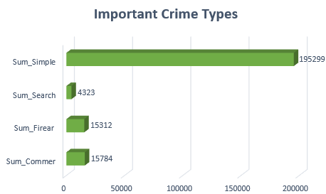
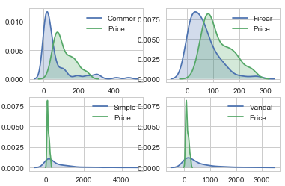
Statistical Analysis —AIRBNB
Large impact Firearm Commercial Burglary Small impact Simple Assault Vandalism

Slide 13
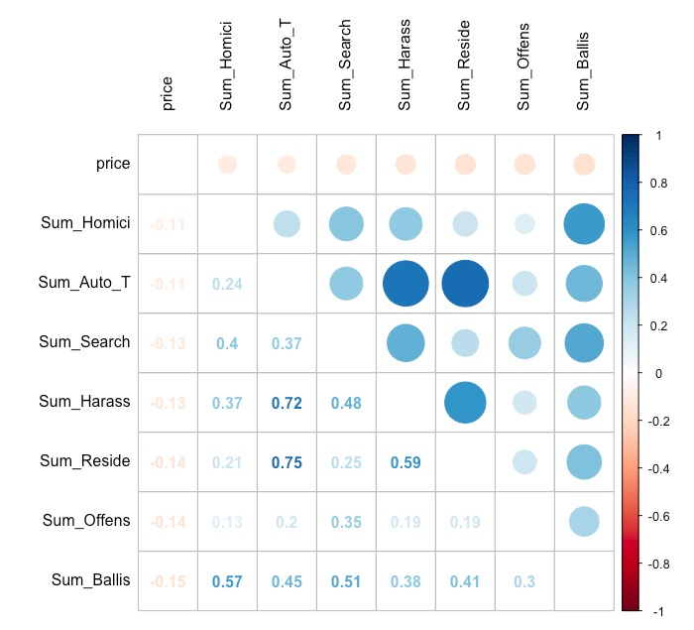
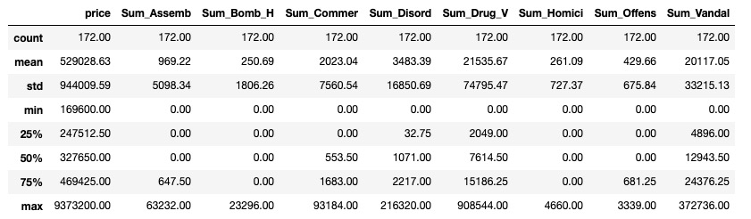
Exploratory Data Analysis —HOUSING
Multicollinearity
Ranges of Dependent variable and independent variables are large we need to normalize data.

Slide 14
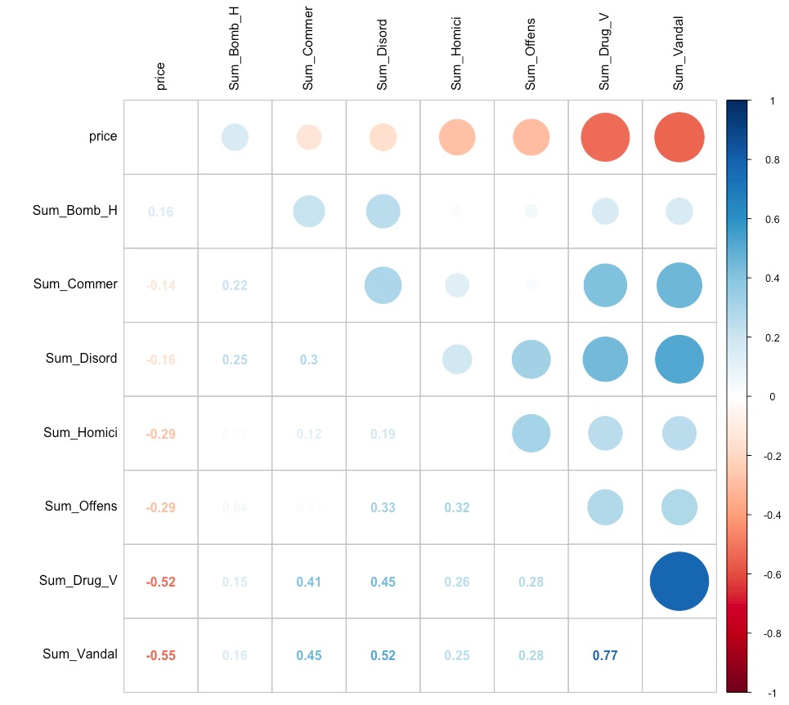
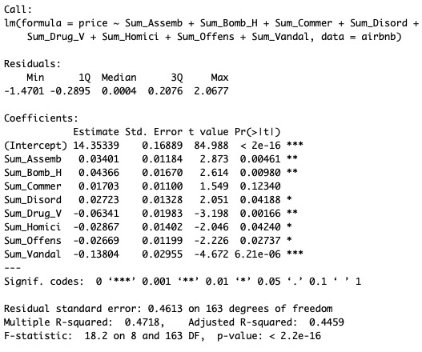
Exploratory Data Analysis —HOUSING
Stepwise Model:

Slide 15
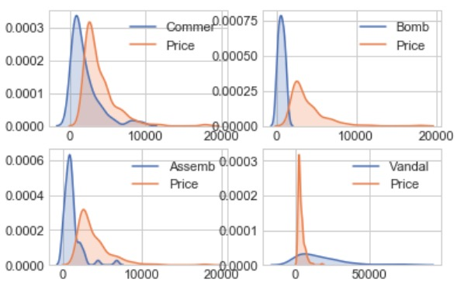
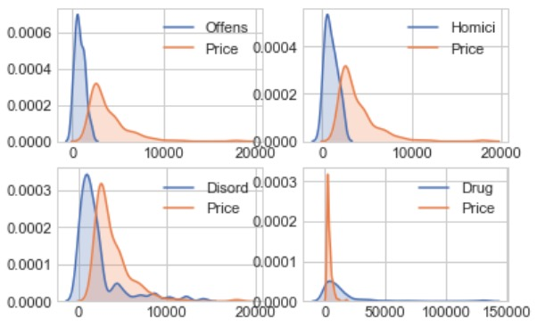
Statistical Analysis —HOUSING
Large impact Commercial Burglary Assembly or Gathering Violation Disorderly Conduct Small impact Bomb Hoax Drug Violation Vandalism Offenses Against Child/Family Homicide

Slide 16
Spatial Analysis —methodology
For spatial analysis we use CARTO to visualize the crime index by census tract.
01
Aggregate Airbnb pricing data and long-term housing pricing data with different crime types by county.
02
Filter the data for counties with top crime incidence for each crime type.
03
Observe average price of Airbnb or long-term housing within those counties with the highest number of crime incidence.
04

Slide 17
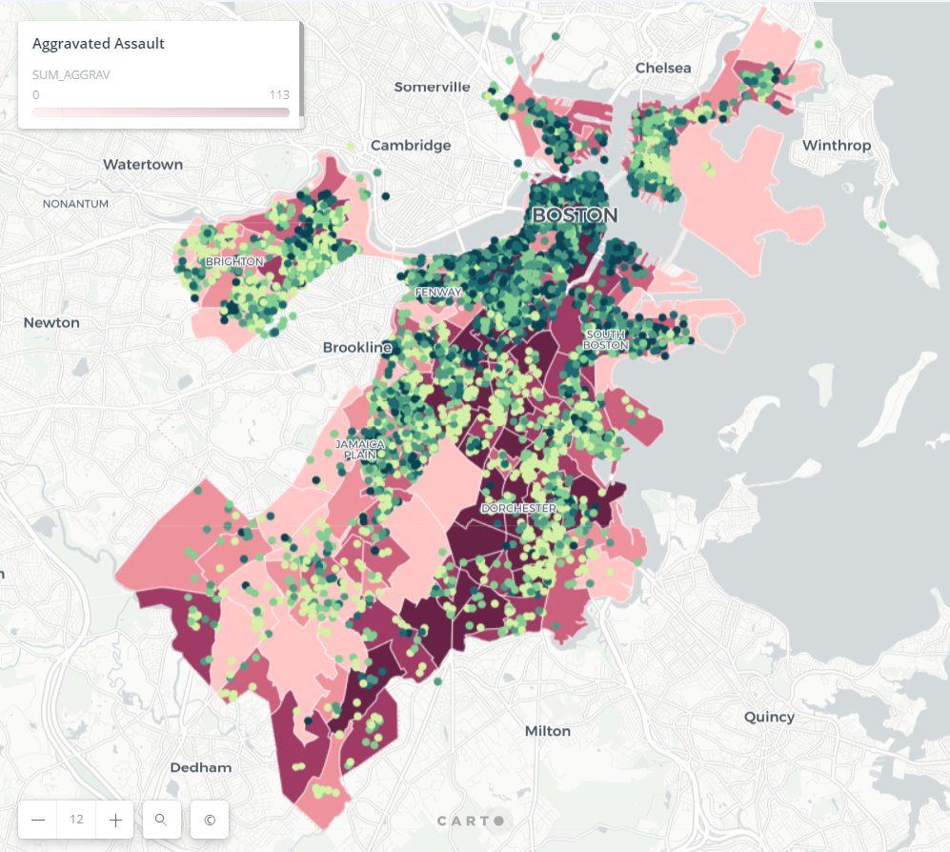
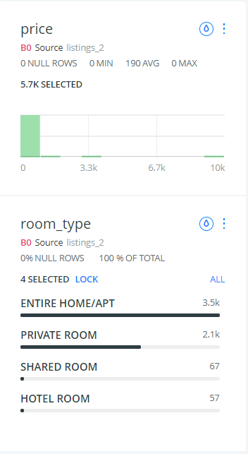
Spatial analysis —AIRBNB

Slide 18
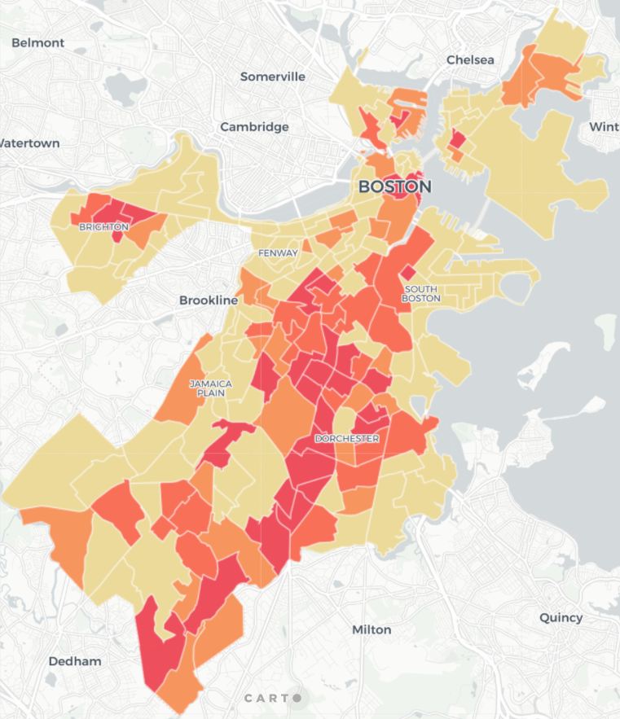
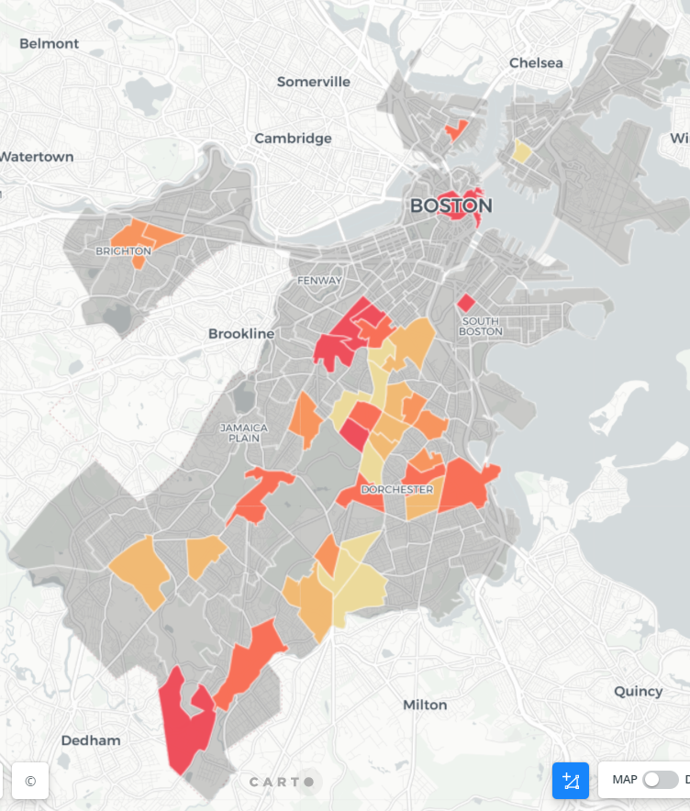
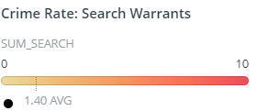
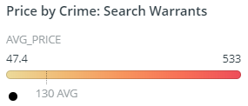
Search warrants —AIRBNB prices
Average Airbnb price
is $130/night for areas with high incidence of search warrants.

Slide 19
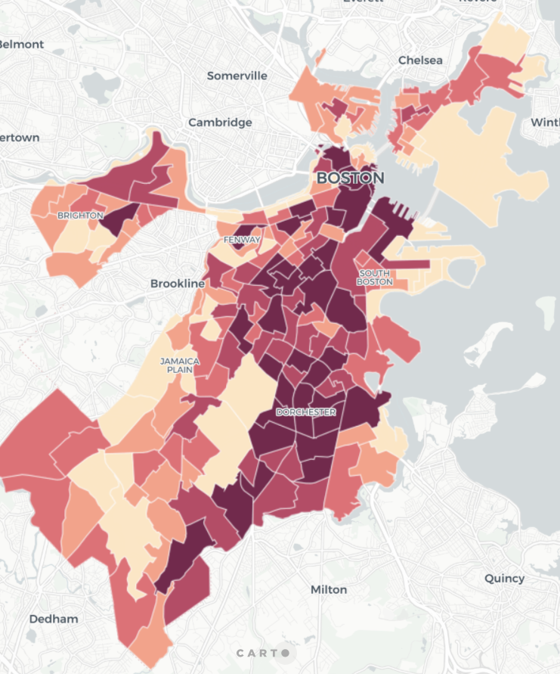
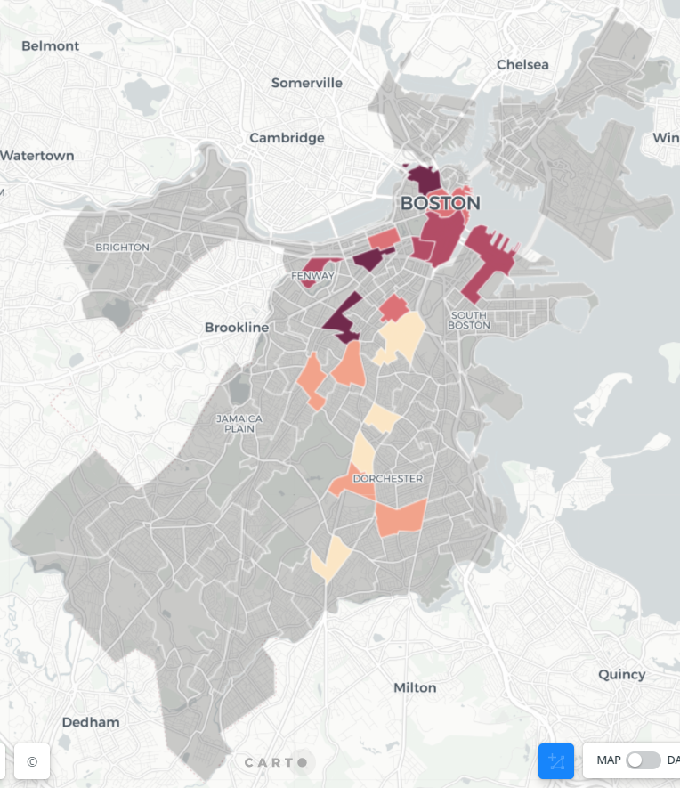
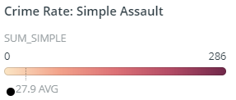
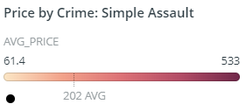
Simple assault —AIRBNB prices
Average Airbnb price
is $202/night for areas with high incidence of assaults.

Slide 20
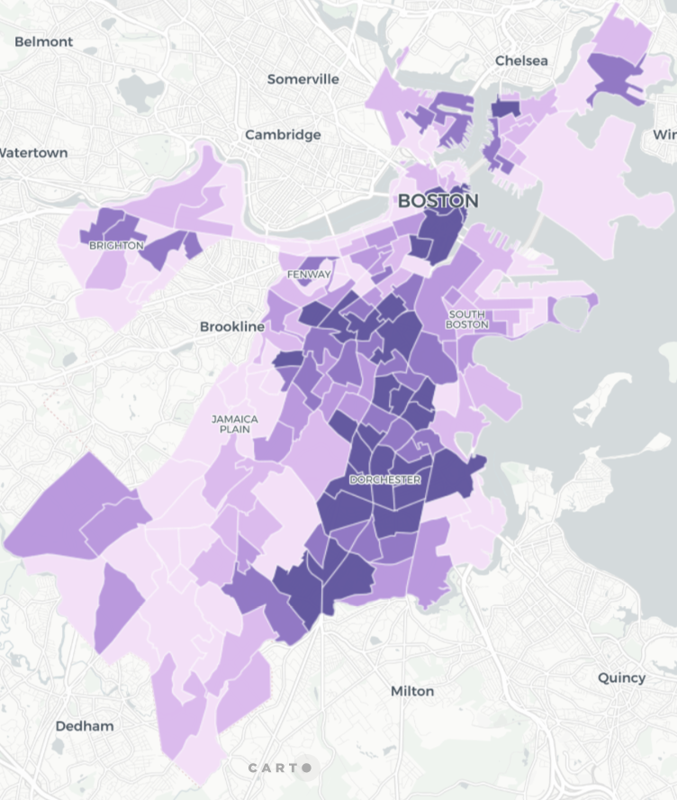
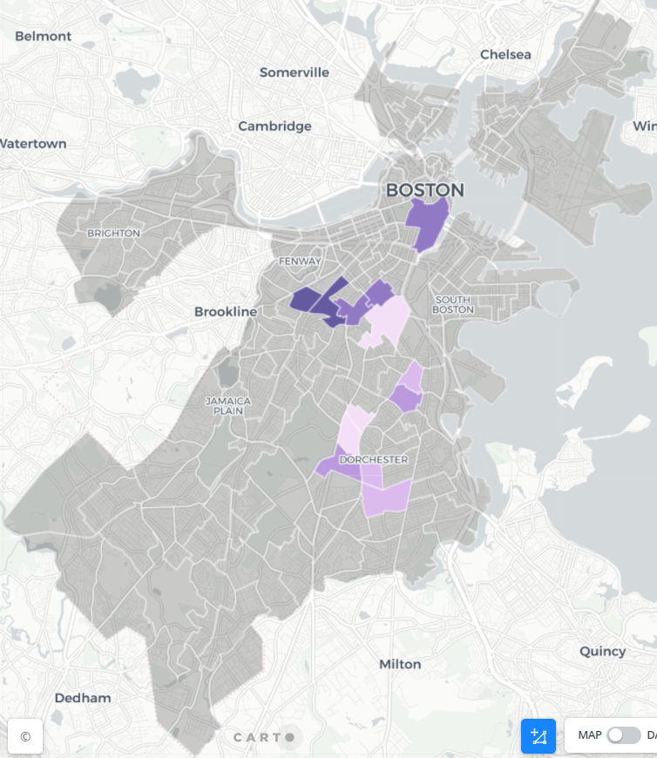
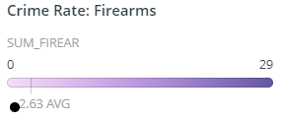
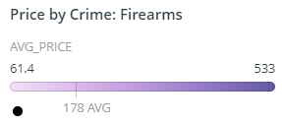
Firearm crimes —AIRBNB prices
Average Airbnb price
is $178/night for areas with high incidence of firearm crimes.

Slide 21
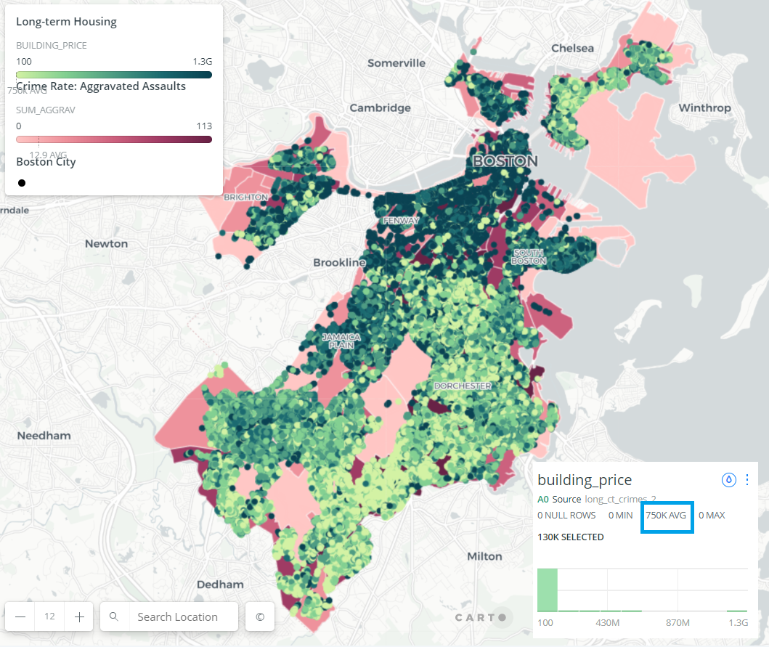
Spatial analysis — long-term housing

Slide 22
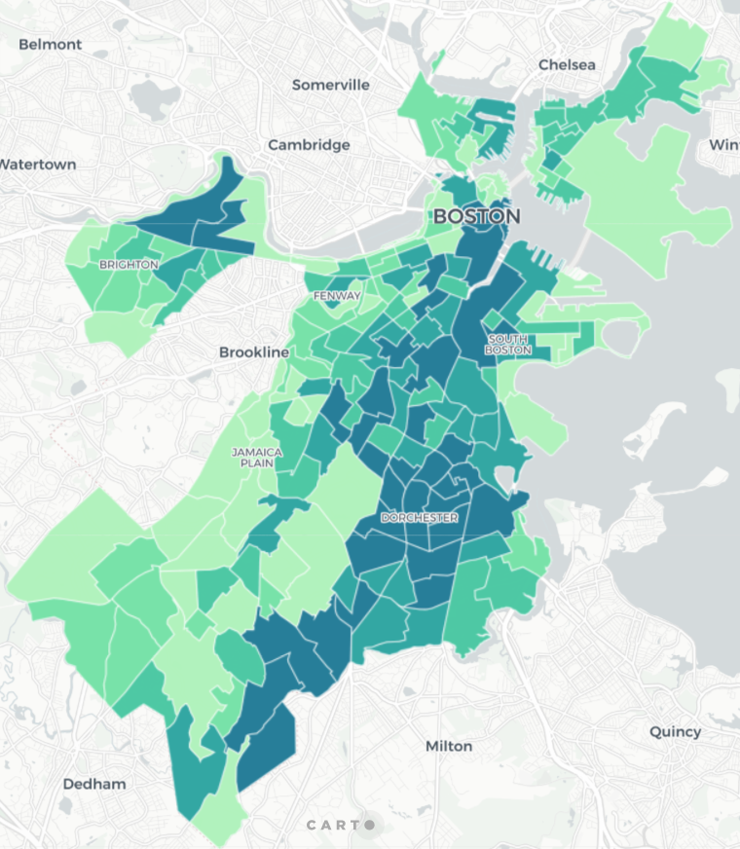
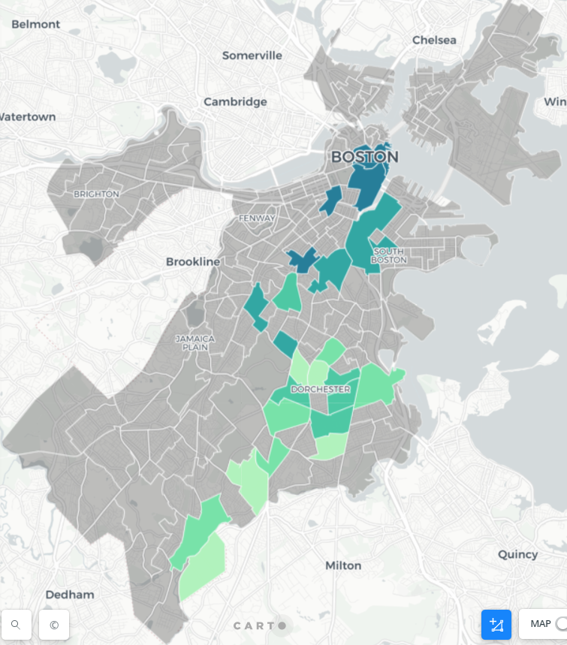
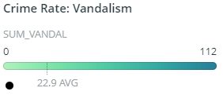
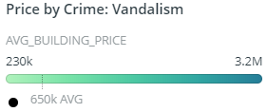
vandalism —long-term housing prices
Average Housing value
is $650K for areas with high incidence of vandalism rates.

Slide 23
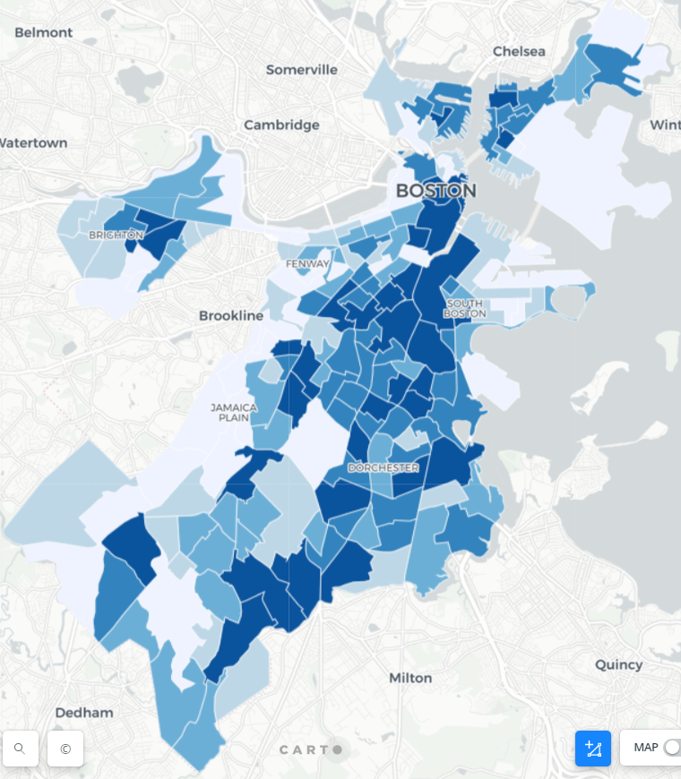
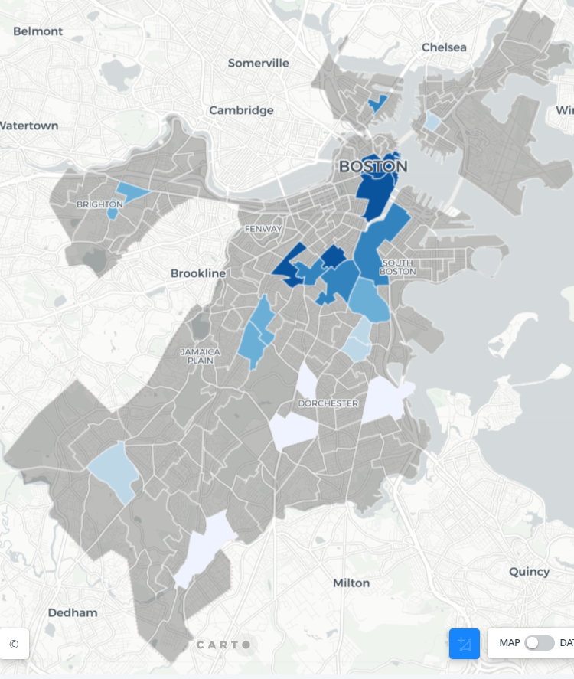
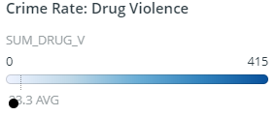
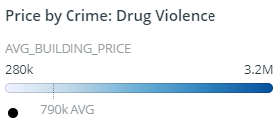
Drug violence —long-term housing prices
Average Housing value
is $790K for areas with high incidence of drug violence rates.

Slide 24
Results
All types of crimes that affect the pricing the most of short-term rentals and long-term housing are different.
Stepwise regression facilitates the process of feature selection based on level of significance.
Bootstrap confirms the results from stepwise regression.
Spatial Analysis confirms the results from the regression models.

Slide 25
Policy implications
It is useful to compare how crime rates influence short-term housing prices against long-term housing prices as residents in the city may have different knowledge of the neighborhood environment compared to the short-term visitors.
Suggest more strict screening policies to allow hosts to post their rooms on the Airbnb platform

Slide 26
Thank you!
Limitations:
Prediction model is only based on crime data, not considering other attributes such as housing properties.
Future work:
Normalize price data using square footage.
Questions?

Slide 27
Organization
Yijie Zhi: Data pre-processing and data sources.
Yujia He: EDA and modelling.
Irene Ham Liu: Data analysis, mapping and reporting.

